Slide 1
Introduction to Python
- Kavita Tewani

Slide 2
Agenda
Introduction
Environment Setup
Basic Syntax
Data Types

Slide 3
What is Python
Python is an interpreted, object-oriented, general purpose, high-level programming language with dynamic semantics.
Available under the GNU General Public License (GPL).
Python supports multiple programming paradigms, including object-oriented, imperative and functional programming or procedural styles.

Slide 4
It features a dynamic type system and automatic memory management and has a large and comprehensive standard library.
Its high-level built in data structures, combined with dynamic typing and dynamic binding, make it very attractive for Rapid Application Development.
Python's simple, easy to learn syntax emphasizes readability and therefore reduces the cost of program maintenance.

Slide 5
Python Features
Easy to read, learn and code
Free and open source
Object Oriented Language
GUI Programming Support
High-level Language
Extensible Language
Portable Language
Interpreted
Large Library Support
Dynamically types Language

Slide 6
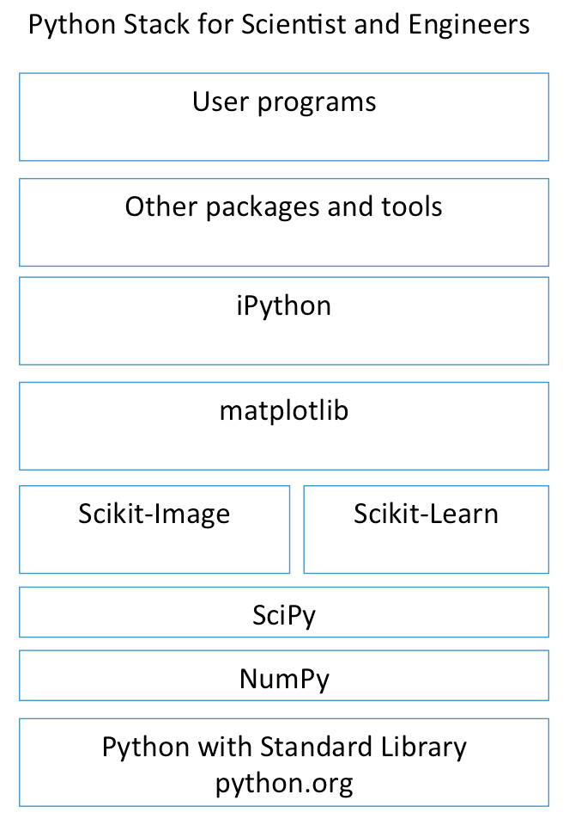
Python for Science and Engineering
Many add-ons and extensions have been created to
allow python to work for S&E’s, web development,
big data processing, and other software stacks”.
iPython is now called Jupyter

Slide 7
Getting Python
Most up-to-date version is available on the official website of Python
https://www.python.org/
It is available for a wide variety of platforms.

Slide 8
Various ways to start Python
Immediate Mode
Enter python command to get following prompt
>>>
The python interpreter is ready for input
Eg.
2+3
Once you press enter, the output will be given on the same screen

Slide 9
2. Script Mode
Used to execute Python program written in a file called a script
Python scripts have the extension .py
To execute this file in script mode we simply write python helloWorld.py at the command prompt
Or it can be run to the Python shell

Slide 10
3. Integrated Development Environment (IDE)
IDE is a piece of software that provides useful features like code hinting, syntax highlighting and checking, file explorers etc. to the programmer for application development
IDLE is the IDE installed along with the Python programming language and is available from the official website
Others are
Jupyter notebook
Spyder
PyCharm
PyScripter
PythonWin

